Slide 1
Lecture 8 Finding Shapes
COMP3204 Computer Vision
How can we group points to find shapes?
 | Book pp 187-201; 208-215

Slide 2
Content
How do we define and detect shapes in images?
How can we improve the detection process?

Slide 3
Feature extraction by thresholding
Conclusion: we need shape!

Slide 4
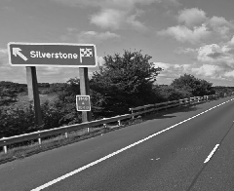
Template Matching -basis
Process of template matching
count of matching points
image
template
accumulator space
Suggestions for improving the process?
Use edges!

Slide 5
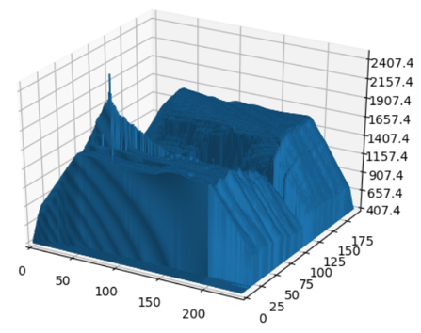
Template Matching
Intuitively simple
Correlation and convolution
Implementation via Fourier
image
template
accumulator space

Slide 6
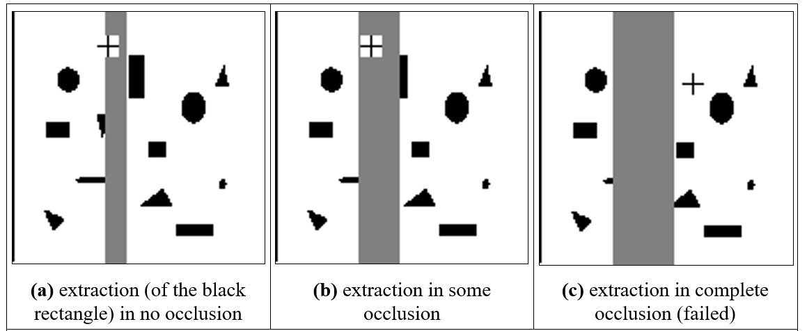
Template matching in occluded images
Template matching is optimal in occlusion

Slide 7
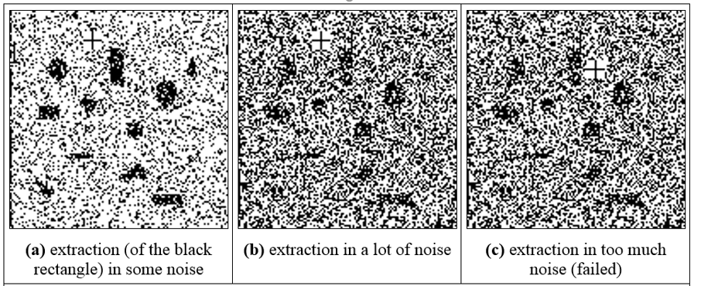
Template matching in noisy images
Template matching is optimal in noise
…but….

Slide 8
Convolution and correlation
Beware centring with transforms
Convolution is about application of a template
and involves flipping the template $I∗T=\sum_{\left(x,y\right)∈W}{I_{x,y}T_{i−x,j−y}}$
or by multiplying the transforms $I∗T=F^{−1}\left(F\left(I\right).×F(T)\right)$

Slide 9
Convolution and correlation
Beware centring with transforms
Convolution is about application of a template
and involves flipping the template $I∗T=\sum_{\left(x,y\right)∈W}{I_{x,y}T_{i−x, j−y}}$
or by multiplying the transforms $I∗T=F^{−1}\left(F\left(I\right).×F(T)\right)$
Correlation is about matching of a template $I⊗T=\sum_{\left(x,y\right)∈W}{I_{x,y}T_{x+i,y+j}}$

Slide 10
Convolution and correlation
Beware centring with transforms
Convolution is about application of a template
and involves flipping the template $I∗T=\sum_{\left(x,y\right)∈W}{I_{x,y}T_{i−x, j−y}}$
or by multiplying the transforms $I∗T=F^{−1}\left(F\left(I\right).×F(T)\right)$
Correlation is about matching of a template $I⊗T=\sum_{\left(x,y\right)∈W}{I_{x,y}T_{x+i,y+j}}$
so we need to flip the Fourier template $I⊗T=F^{−1}\left(F\left(I\right).×F(−T)\right)$

Slide 11
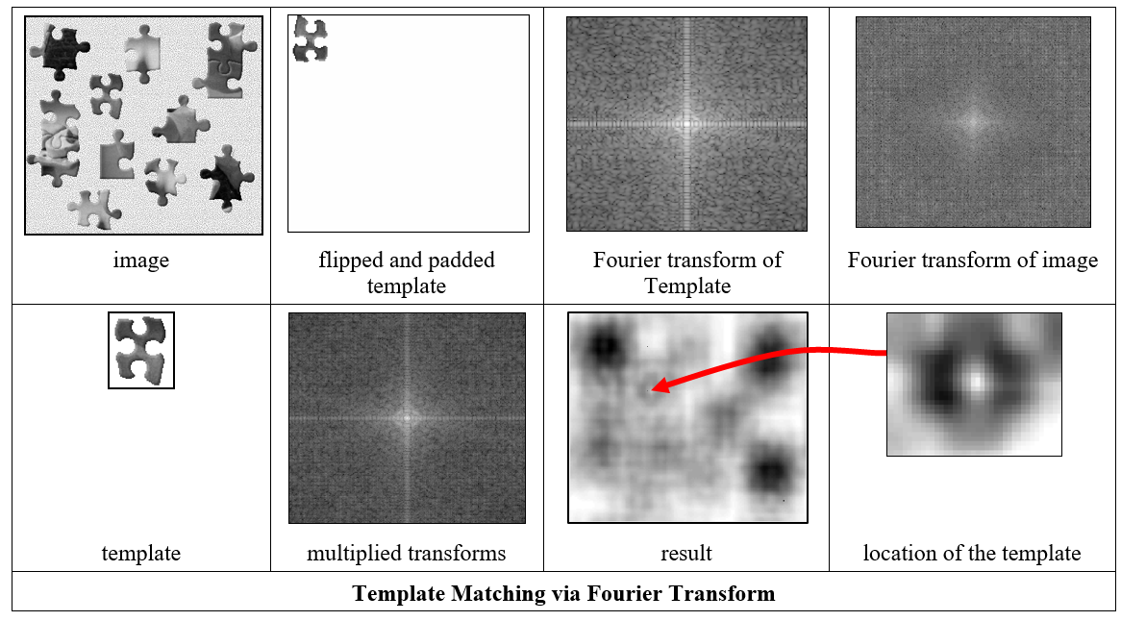
Encore, Baron Fourier!
Template matching is slow, so use FFT
$$I⊗T=\sum_{\left(x,y\right)∈W}{I_{x,y}T_{x+i,y+j}}$$
$$=F^{−1}\left(F\left(I\right).×F(−T)\right)$$
No sliding of templates here;
Cost is 2×FFT plus multiplication

Slide 12
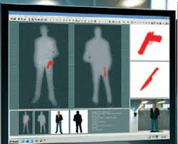
Applying template matching

Slide 13
Hough Transform
Performance same as template matching, but faster
A line is points x, y gradient m intercept c
and is points m, c gradient -x intercept y

Slide 14
Hough Transform
Performance same as template matching, but faster
A line is points x, y gradient m intercept c
and is points m, c gradient -x intercept y
x
m
y
c
image
accumulator space

Slide 15
Hough Transform
Performance same as template matching, but faster
A line is points x, y gradient m intercept c
and is points m, c gradient -x intercept y
x
m
y
c
image
accumulator space
The coordinates of the peak are the parameters of the line
In maths it’s the principle of duality

Slide 16
Pseudocode for HT
accum=0
for all x,y !look at all points
if edge(y,x)>threshold !check significance
for m=-10 to +10 !if so, go thru m
c=-x*m+y !calculate c
accum(m,c) PLUS 1 !vote in accumulator
m,c = argmax(accum) !peak gives parameters

Slide 17
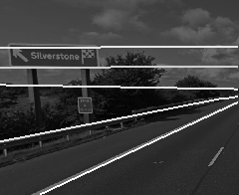
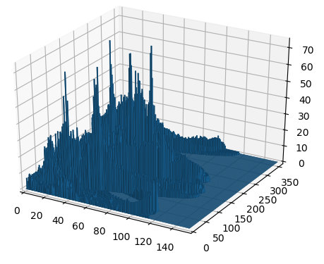
Applying the Hough transform for lines
image
detected lines
accumulator space
OK, it works. Can anyone see a problem?

Slide 18
Hough Transform for Lines … problems
m, c tend to infinity
Change the parameterisation
Use foot of normal
Gives polar HT for lines
Image containing line

Slide 19
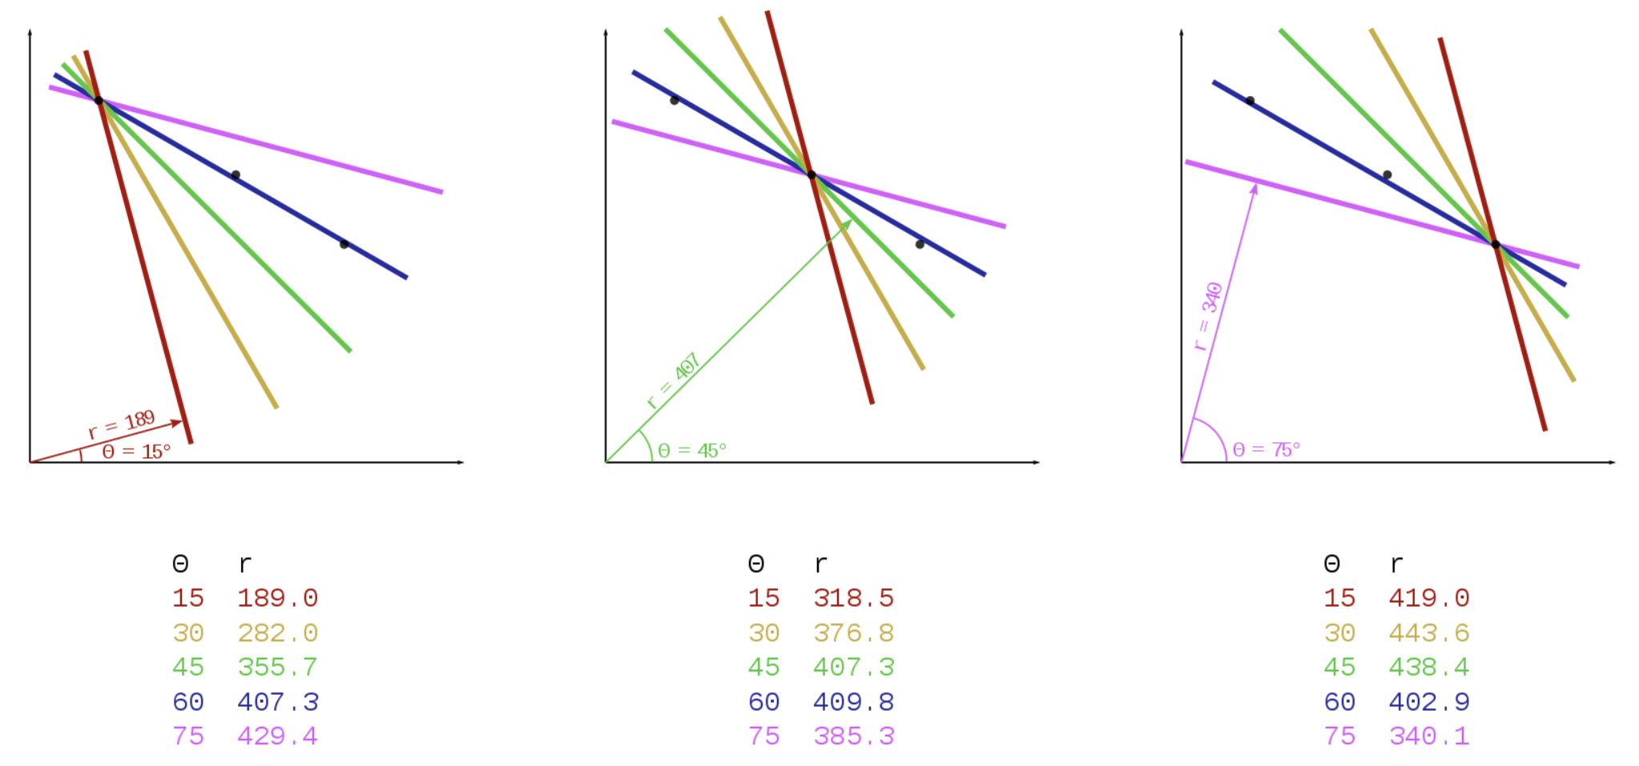
Polar Hough transform for lines
[Credit Wikipedia]

Slide 20
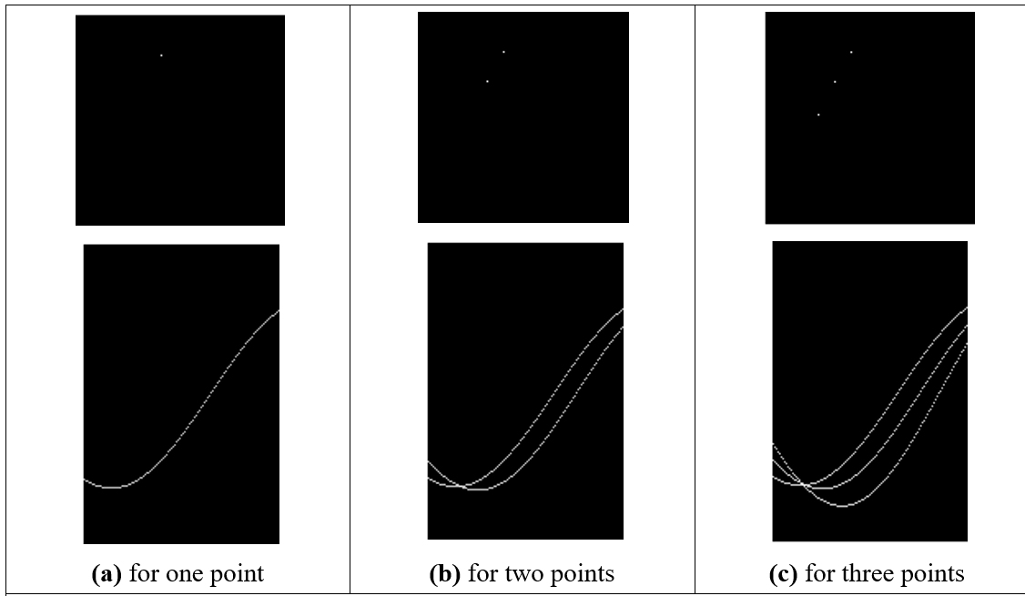
Images and the accumulator space of the polar Hough transform

Slide 21
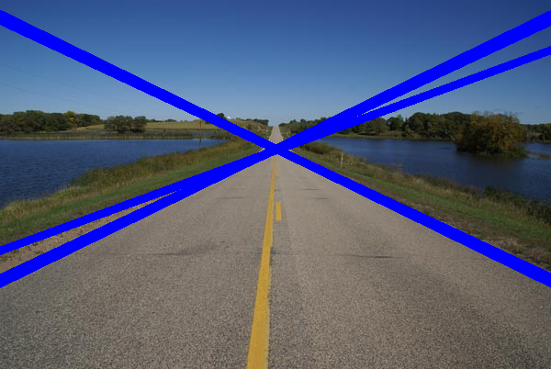
Applying the Hough transform

Slide 22
Main points so far
1 – target shape defined by template
2 – and detected by template convolution
3 – optimal in occlusion and noise
4 – Hough transform gives same result, but faster
But shapes can be more complex than lines and not defined by an equation. That’s next…
Notes:
J&S fish

Slide 23
Notes:
J&S fish

